Slide 1
Term Project Write-Up
Group Amber
Ansh Riyal, Sabrina Sheu, Sidharth Shyamsukha

Slide 2
Business Understanding
Business Problem:
Predict the probability that a potential borrower will default on a principal or interest payment for a prospective loan over the next 12 months based on the data available up to the statement date (after adjusting the timeline on the basis of the firm year (typically ending in March/April) instead of the fiscal year (January 1 - December 31)).
How (precisely) will a data mining solution address the business problem?
Data mining will help in clean up the data and reduce the features so that the model can use just the main or aggregated features which directly affect the target variable “Default”.
What has been done in the past?
In the past, models like Merton, Altmann’s, etc. calculated default using statistical approaches by using ratios of features and finding correlations between those variables and default.
The primary reason for that was the lack of computational resources to find a non-closed form solution.
The coefficients and ratios they derived are both brilliant up to a certain point and we have tried to use those as inspiration for our approaches.

Slide 3
Data Understanding
The company that defaulted was identified based on the default date which were within 1 year of the statement date.
For default dates in range Jan-Apr, the prior year was skipped for reference, but for default dates in May-Dec the prior year was considered.
Variables derived from dataset include liquidity ratios such as current ratio, quick ratio, etc. along with activity ratios such as working capital turnover, etc.

Slide 4
Data Preparation
All the assets and liabilities were aggregated.
The variables equity_tot, asset_tot and profit were normalized as they varied over a wide range of values.
The default date and default target variable were shifted for the Jan-Apr months in the preprocessor.

Slide 5
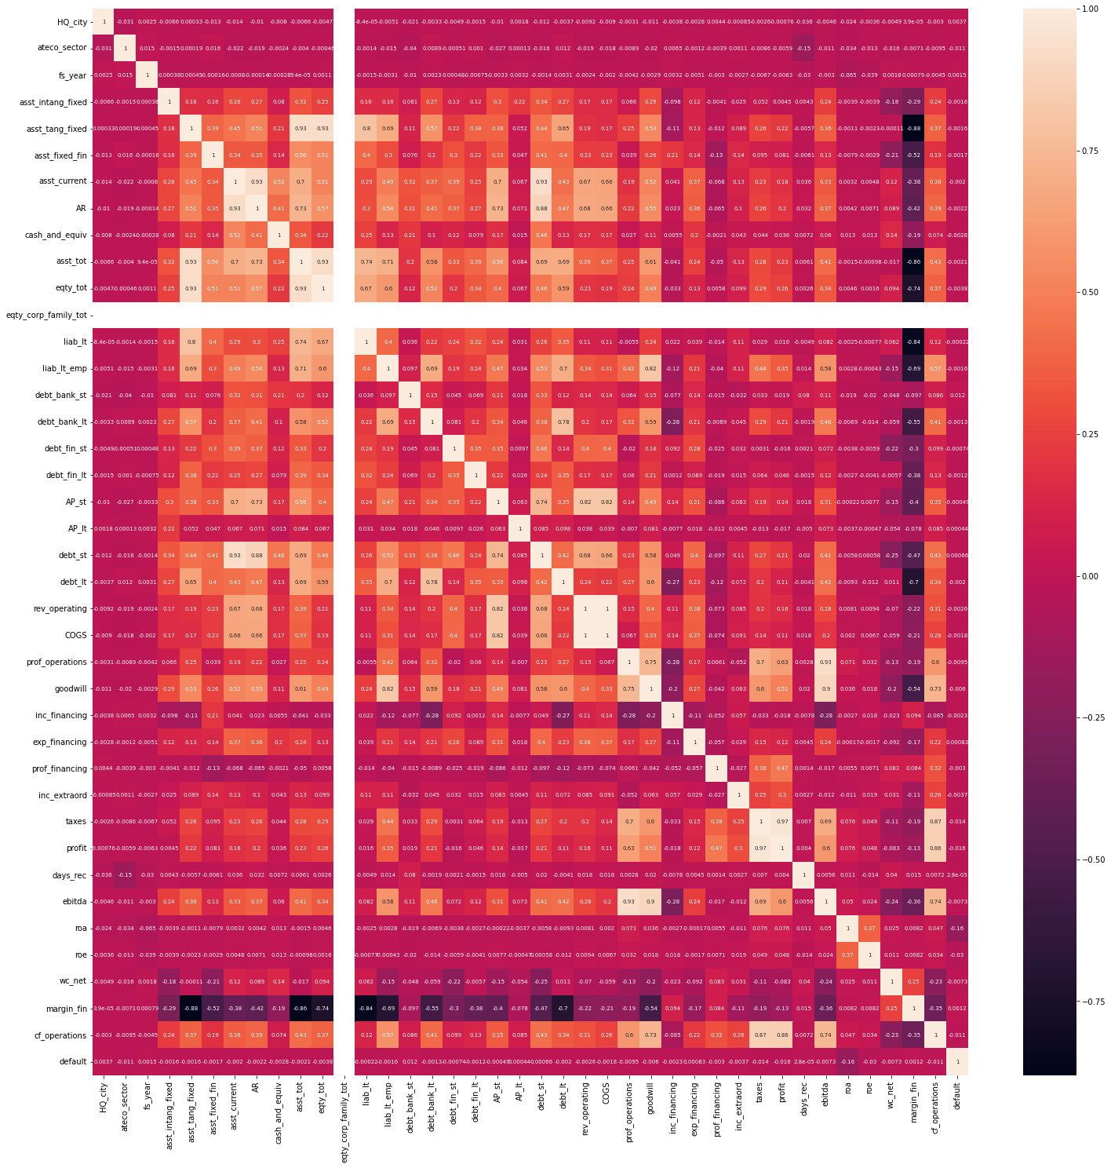
Input feature correlations
As we can see, there are not many highly correlated (with the target) variables.
However, there are many variables which are quite correlated with each other.
In order to avoid duplication of information in the input features, we select the following variables (after grouping variables according to mutual corr. As well as some experimentation):
Total Assets, total equity

Slide 6
Extracted features
We are extracting the following ratios from the given data:
Liquidity Ratios:
Quick ratio, current ratio, cash ratio, cfo ratio,
Activity Ratios:
working capital turnover ratio, fixed assets turnover ratio.
Other than these, we also use extracted principal components for 2 approaches (Logit model with PCA and Neural Network with PCA).
Quick ratio and asset turnover ratios were used as the input to the neural network model as these had the most correlation with default among all the other ratios.

Slide 7
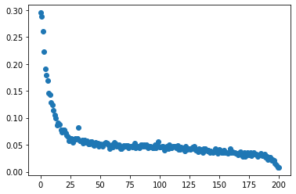
(Not) Grouping by Ebitda Values
This is the scatterplot of default ratios according to percentiles of Ebitda values.
As we can see, the default ratios are distributed according to Ebitda values.
This implies that ebitda values are a very good indicator of probability of default, specially at the lowest 20% Ebitda values.
We originally planned to group together the Ebitda values and One Hot Encode them. However, there is no clear separation boundary between different groups here, so instead, we normalized the values and used them.

Slide 8
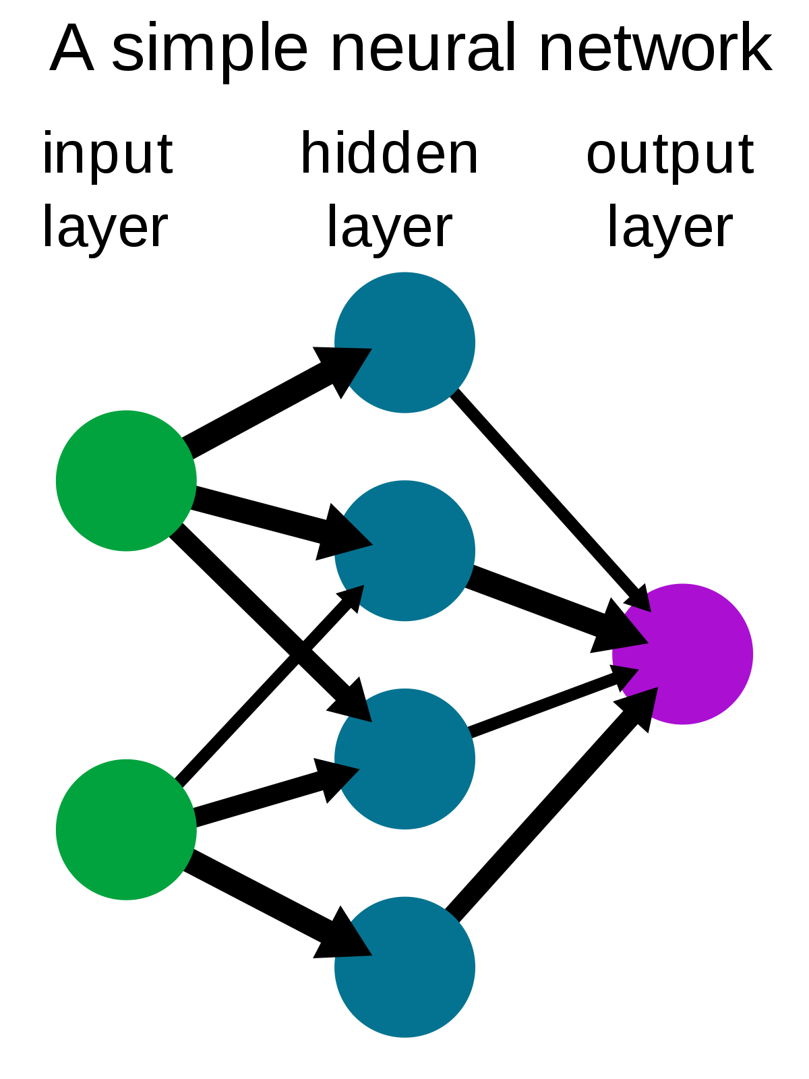
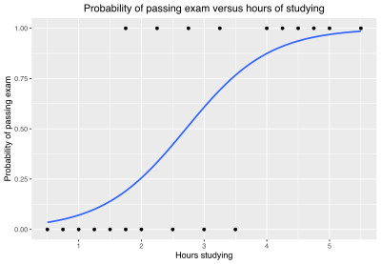
Modeling

Slide 9
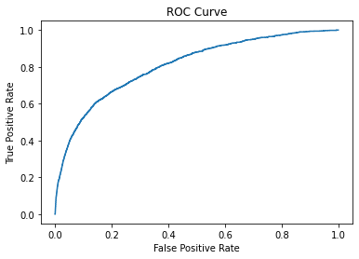
Logit Model:
Input features to the model:
Asst_tot, eqty_tot, profits, ebitda, roa, quick ratio, fixed asset turnover
Correlation coefficients: Asst_tot(-4.3), eqty_tot(-3.79), profits(-4.6), ebitda(-4.88), roa(-1.83), quick ratio(-1.19), fixed asset turnover(1.19)
Roc curve:
Auc value: 0.79421
Remarks: This is a simple, but powerful model. Based on the data available, it has a really good discriminatory power compared to most approaches and it is the most interpretable.

Slide 10
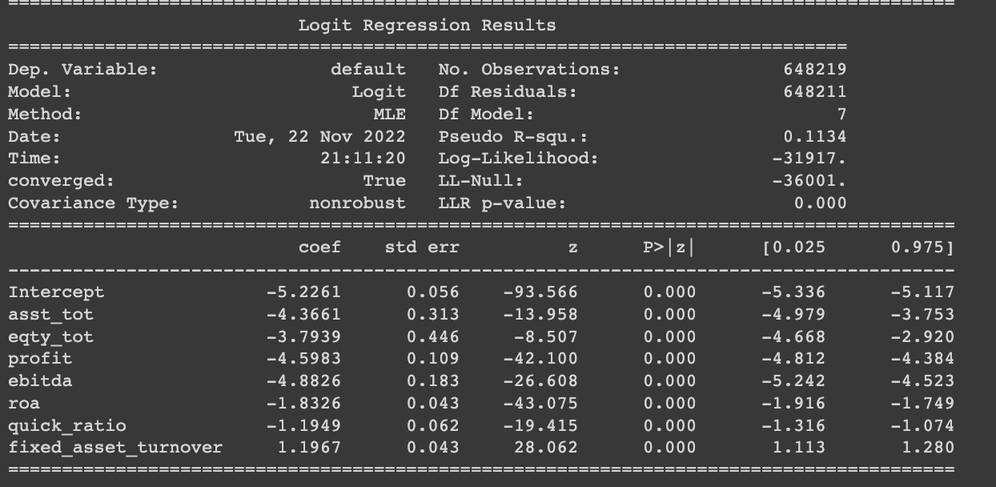
Logit model (cont.)
Pros:
Simple model, thus easy to explain
Quick, thus can be retrained multiple times to experiment with data.
Gives great results when the underlying function is linear.
Cons:
Can not map complex relationships
Easily destabilizes when input features are heavily correlated

Slide 11
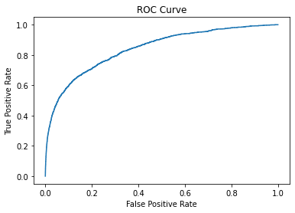
Simple Neural Network:
Input features to the model:
Asst_tot, eqty_tot, profits, ebitda, roa, quick ratio, fixed asset turnover
Model Architecture: 1 input layer, 2 hidden layers, 1 output layer
Roc curve:
Auc value: 0.84043
Remarks: This model only used relu activation functions and 2 hidden layers, so it is still relatively fast and we get lower False Positive rates compared to the logit model.

Slide 12
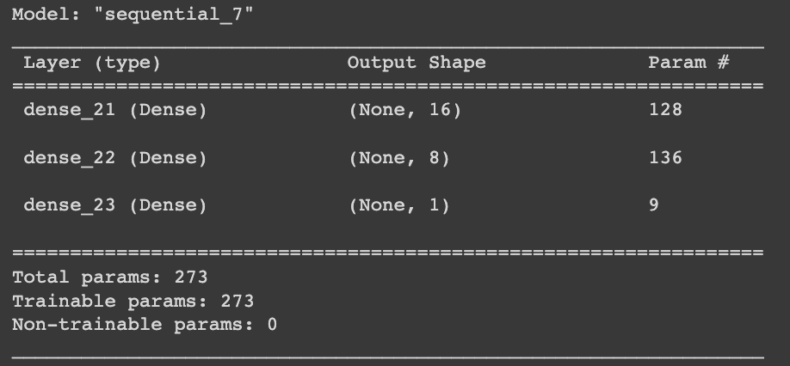
Simple Neural Network(cont.)
Pros:
Can easily map complex relationships
Work well with both linear and non linear relationships.
Cons:
Higher computational complexity required for running in real time.
Difficult to control (Black Boxes)

Slide 13
Evaluation
Benchmark calculation:
Model comparison done based on metrics such as the AUC scores.
Precision and Recall values of all the models were used as a benchmark to see the performance of model at the optimal threshold value.
Business case:
Banca Massiccia can set the threshold based on how it wants to minimize the cost. This should identify the customers who would be classified as defaulters or non-defaulters.
Based on the preliminary and basic optimal threshold for categorising defaulters and non defaulters er are able to see that the simple neural network is able to give lesser number of false positives compared to the logit model, however logit model is simpler and easier to interpret so depending on Banca Massiccia preference for false positives rate it can choose between both the models.
For our purpose s we are recommending the simple neural network based on the performance of model.

Slide 14
Deployment
Discuss how the result of the data mining will be deployed
The data mining approach includes 2 primary components: the feature extraction and the modelling.
The feature extraction by themselves are useful for further calculations in order to make decisions based on the risk appetite of the client.
The modelling approach basically provides us with the probability of a company defaulting (separated into decisions according to the optimal threshold). This threshold can be re calculated according to the cost-benefit matrix of Banca Massiccia’s operating costs and benefits.
The probability in itself can be used to rank companies in order to decide the rate of interest which can be offered to them.
Lastly, the rate of interest that the bank will derive from the PDs, will be one of the deciding factors about whether or not Banca Massiccia can legally offer the loan under consideration.
Discuss issues the bank should be aware of regarding deployment.
Are there important ethical or legal considerations?
Describe settings in which your results should not be applied.
Identify the risks associated with your proposed plan and how you would mitigate them.

Slide 15
Deployment(Contd.)
Our model gives the probability of a company defaulting on a loan.
This output can be used to rank candidate companies and in order to decide which companies to give loan to, depending on the risk appetite of our client bank.
Discuss issues the bank should be aware of regarding deployment.
Ebitda is a really good indicator, but if we go with our model, then small companies will get higher probabilities of default, which will in turn lead them to get a higher rate of interest and thus default even more.
Describe settings in which your results should not be applied.
Our model is quite simplistic, but it might not be as robust as we would like it to be in cases where we go above/below the scale of the companies in our dataset, so it will not work with big companies or small companies.
Being a neural network, there might be a computational requirement which might lead to slower processing times and thus might not be suitable for instantaneous results

Slide 16
Bibliography
https://www.mathworks.com/help/risk/default-probability-using-the-merton-model-for-structural-credit-risk.html
https://www.investopedia.com/terms/a/altman.asp
https://arxiv.org/pdf/math/0407060.pdf
https://scikit-learn.org/stable/modules/generated/sklearn.metrics.confusion_matrix.html
https://pandas.pydata.org/docs/
https://www.tensorflow.org/api_docs/python/tf/keras

Slide 17
Primary contributions:
Ansh Riyal : Feature extraction, EDA, Modeling, Slides
Sabrina Sheu : EDA, Harness functions, preprocessing, Modeling, Slides
Sidharth Shyamsukha: Modeling, subject research, EDA, Slides

